Slide 1


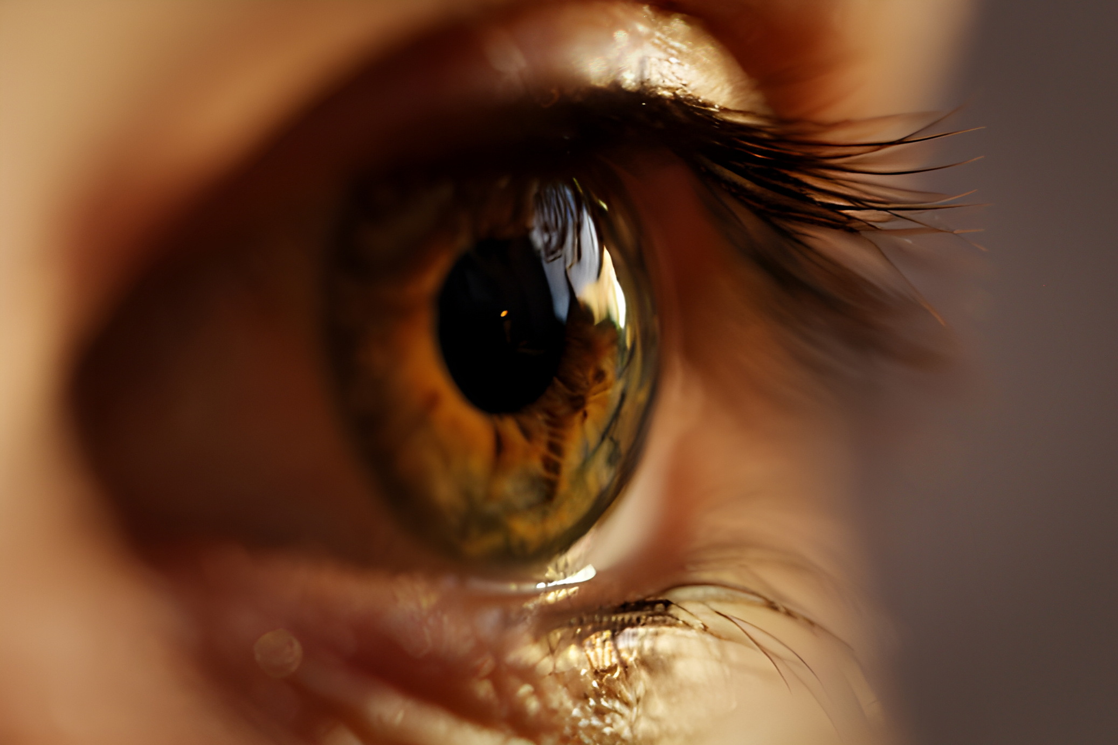

Unwanted Cells Detector In The Eye

Slide 2
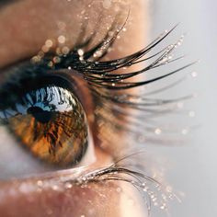
Group Members
GAHDSE23.3F 003 – DEVINDI H. M
GAHDSE23.3F 004 – SANDEEPANI G. K. N
GAHDSE23.3F 010 – NISKA A. Z. F. N
GAHDSE23.3F 008 – SANDAMALI T. D
GAHDSE23.3F 011 – VISHMINA M. G. U

Slide 3

Contents
Introduction
Problem Statement
Objectives
DIP techniques
Tools and libraries
Conclusion

Slide 4

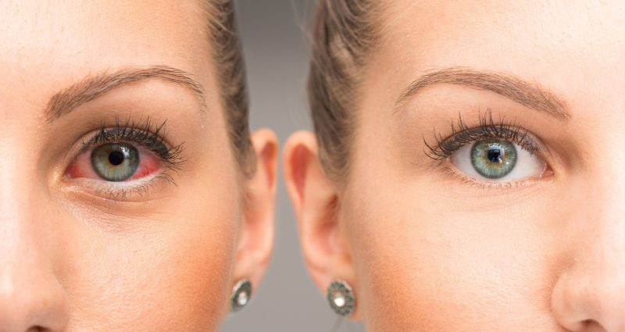
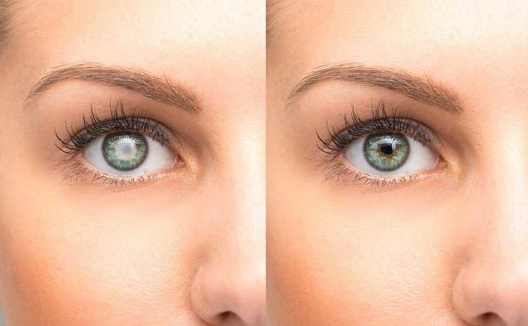
Introduction
Digital image processing is a powerful tool for analyzing images.
Early detection of these diseases is crucial for preventing blindness.
Our tool uses DIP to analyze eye images and find signs of cataracts and glaucoma.

Slide 5
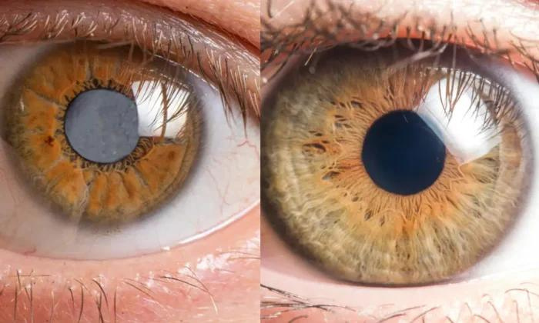
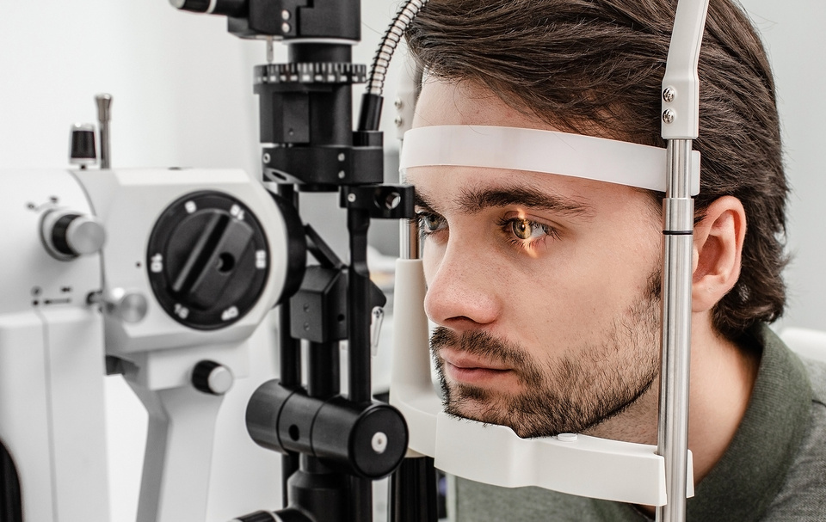
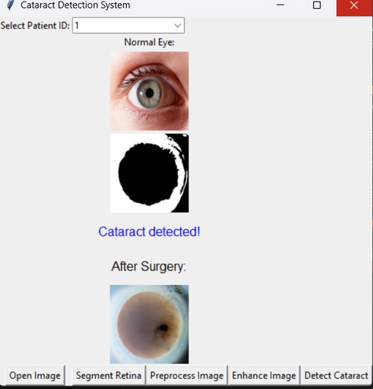
Problem Statement
The Global Burden of Cataracts and Glaucoma
Limitations of Existing Diagnostic Methods
Our Proposed Solution

Slide 6
Objectives
Develop a user-friendly interface for medical professionals to upload and analyze eye images
Design a system for detecting unwanted cells using DIP
Analyze eye images to identify signs of cataracts and glaucoma

Slide 7
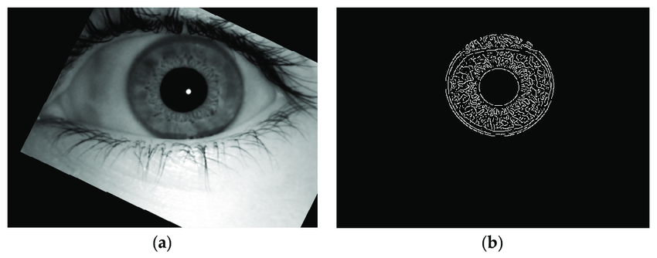
DIP techniques
Image acquisition
Preprocessing
Segmentation
Enhancement
Feature extraction
Classification and detection

Slide 8


Tools and libraries
OpenCV
Python
MySQL

Slide 9
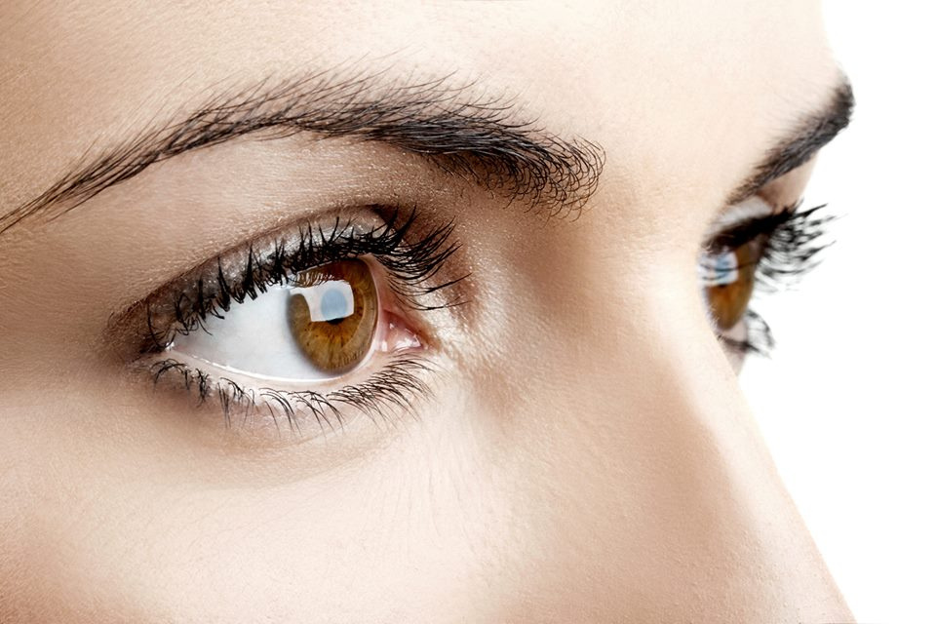
Developed a DIP-based system for
early detection of cataracts and glaucoma.
he system offers a
potentially faster,
more accessible, and cost-effective
diagnostic tool.
Conclusion

Slide 10

Thankyou!

